Slide 1

Navigating the World of Cloud Developer Environments
Isaac Levin
Principal Technical Product Marketing Manager
Red Door Collaborative
Level: Introductory to Intermediate

Slide 2

Session Survey
Your feedback is very important to us
Please take a moment to complete the session survey found in the mobile app
Use the QR code or search for “Converge360 Events” in your app store
Find this session on the Agenda tab
Click “Session Evaluation”
Thank you!

Slide 3










https://www.isaacrlevin.com
@isaacrlevin
https://www.coffeeandopensource.com
@isaacrlevin
@isaacrlevin@fosstodon.org

Slide 4
Agenda
Cloud Developer Environments 101
Some Demos!
Which one is best for me?

Slide 5















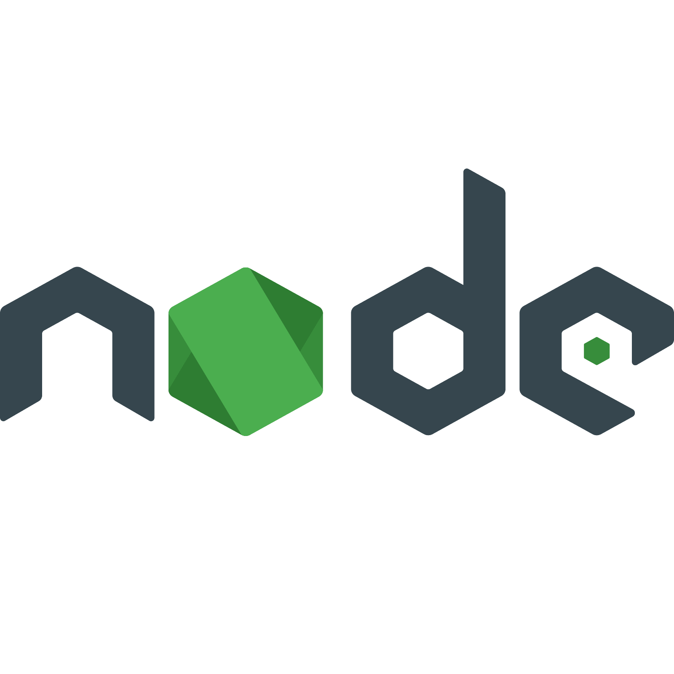


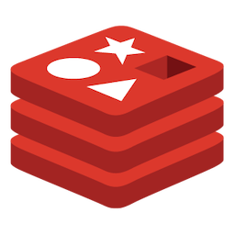
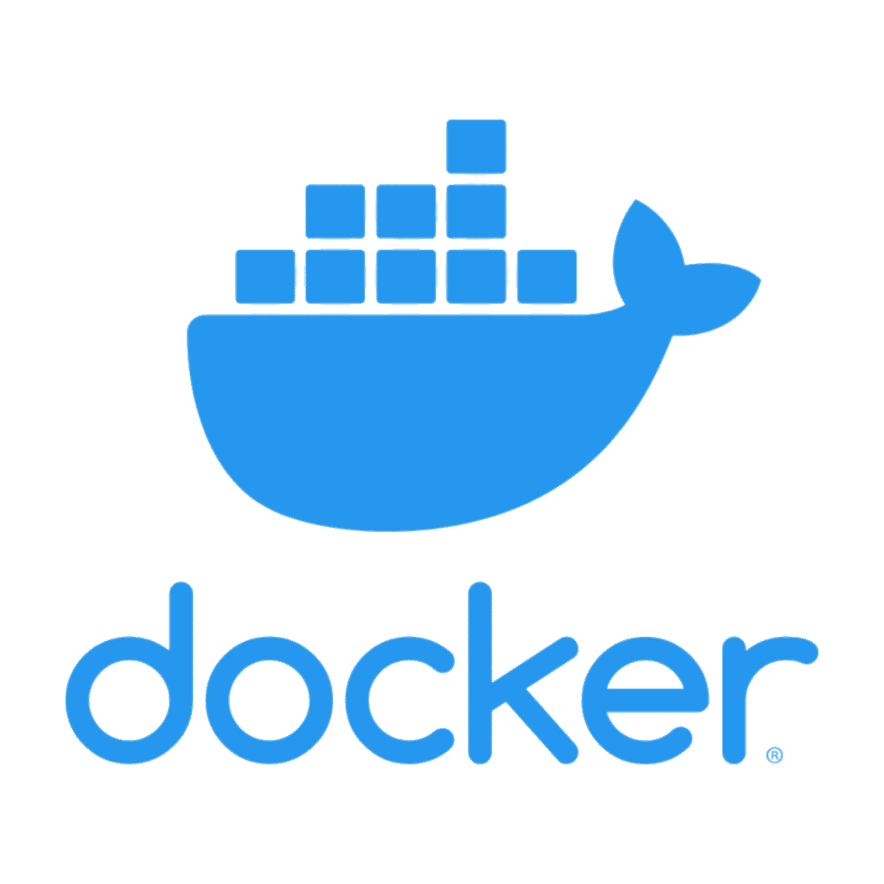



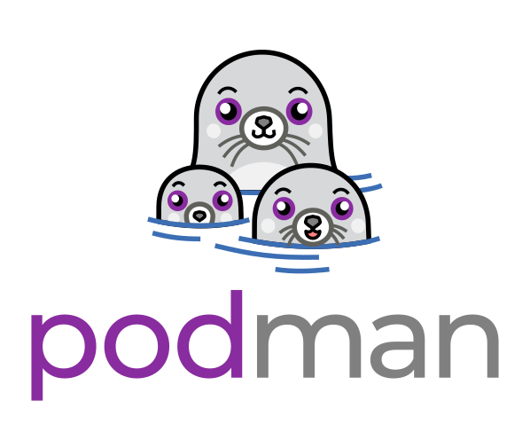


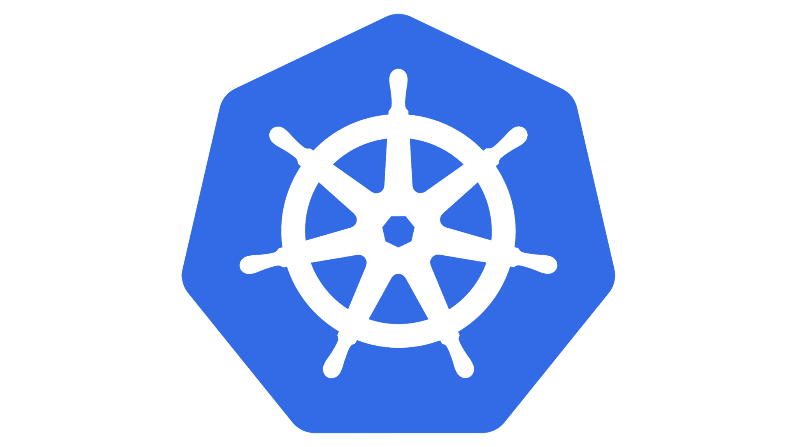
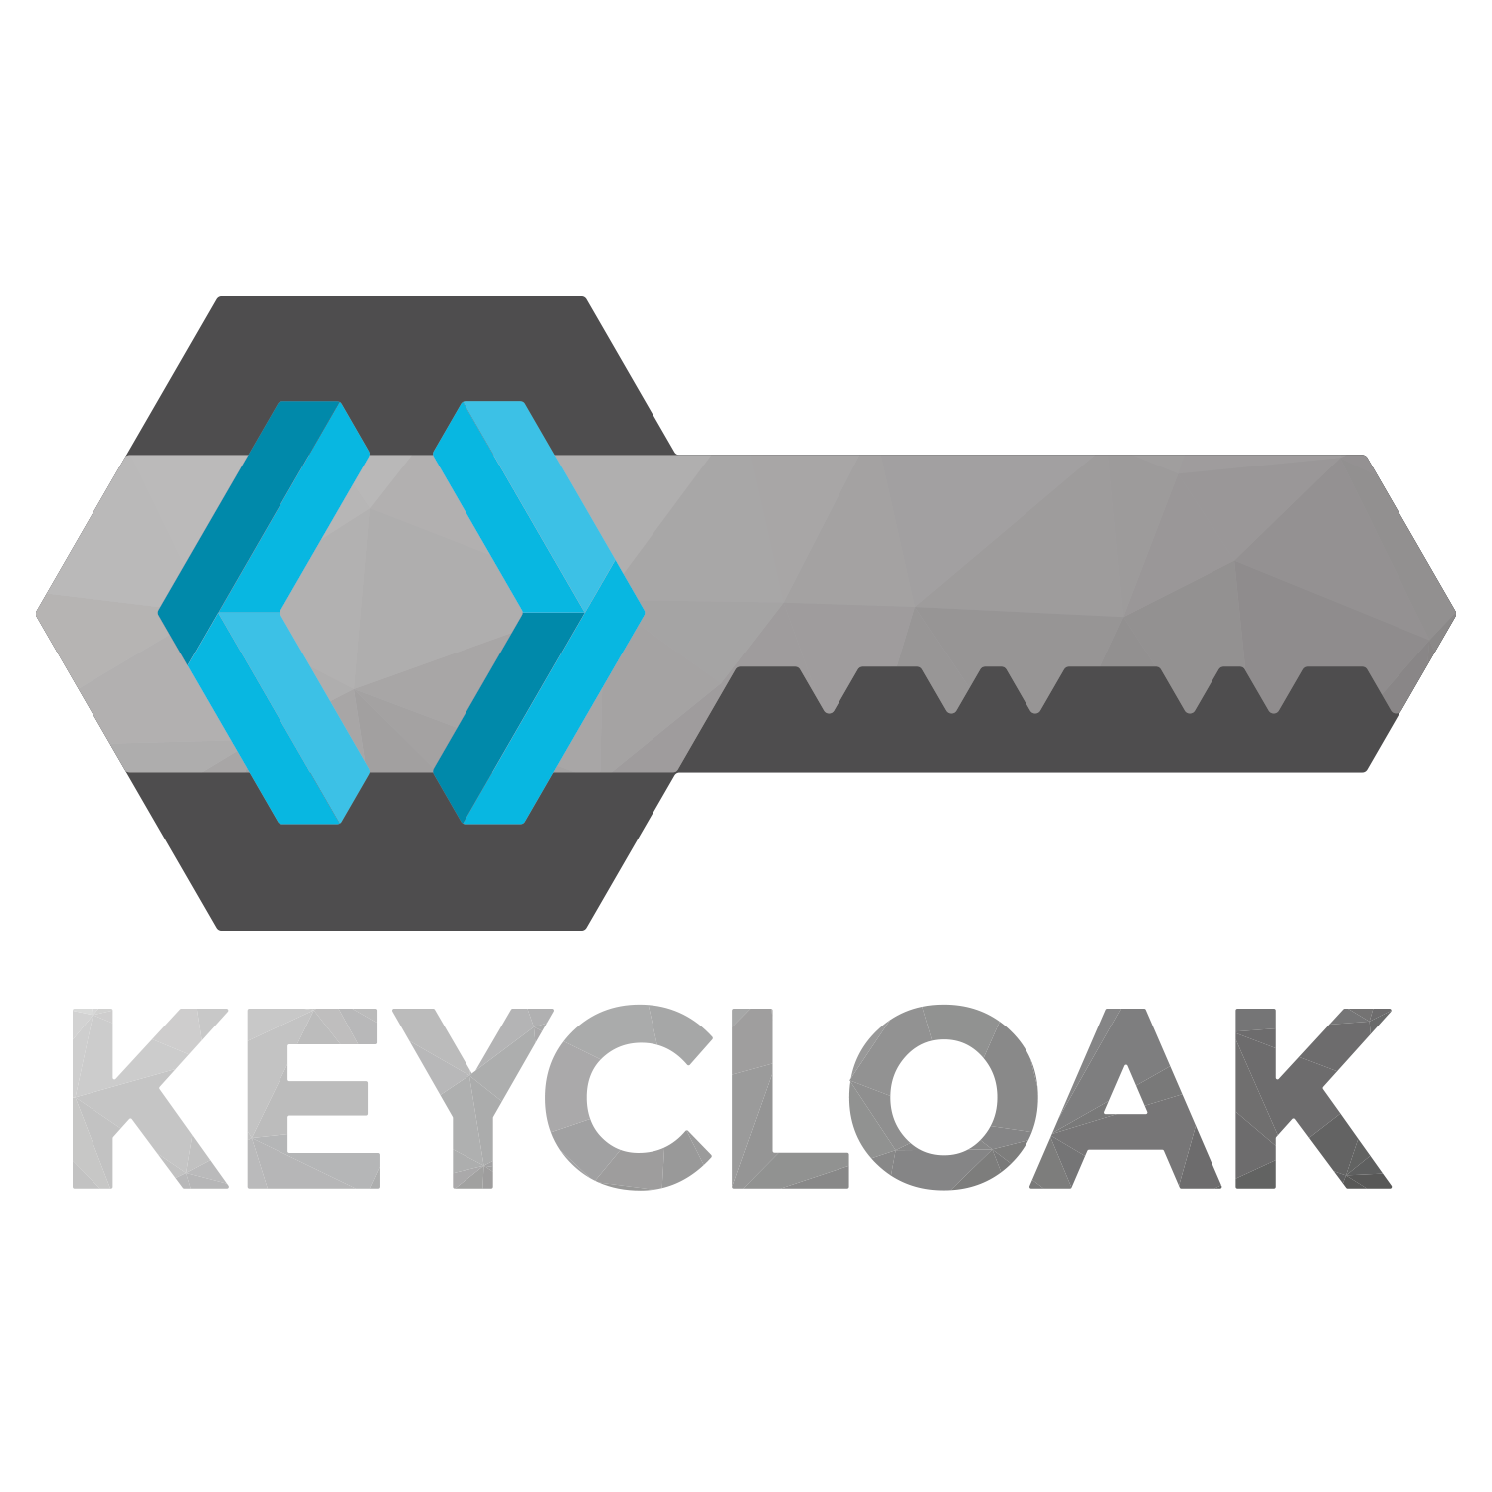

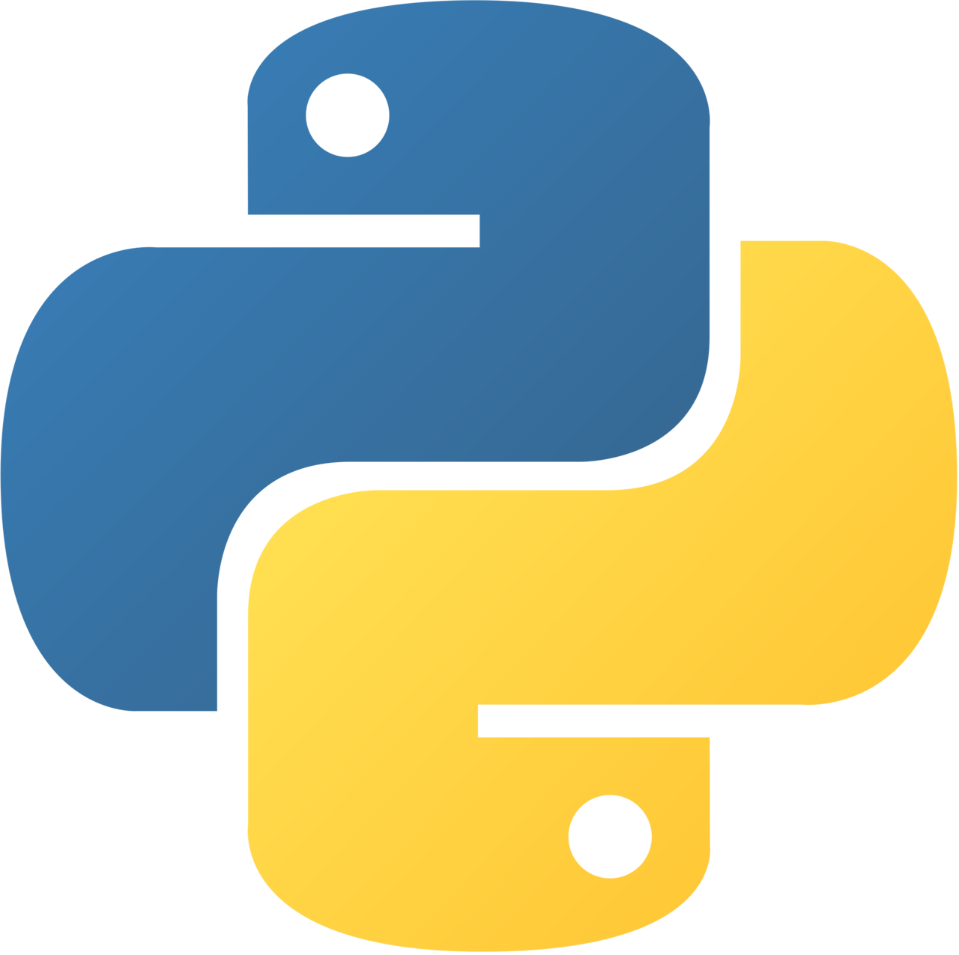
Your average developer deals with:
Caching
Databases
Local development tools
Messaging + queueing
Containers?!
Multiple languages
A zillion deployment targets
Resiliency + scalability
Security + networking
CI/CD
Storage but… not databases?!
Telemetry and logs and traces
Authentication
AI?!?!?!
and so much more!

Slide 6
Acquire all the dev tools
IDE/editor
Language SDKs + runtimes
Container system + emulators
Get all the pieces working individually
Or… deploy to a staging environment
Don’t forget to authenticate! Somehow!
Ever heard of mock data? You have now!
Don’t forget the one random specific thing your company requires!
Connect them all? Maybe?
Or just test them individually and hope it works in prod
If you’re lucky someone wrote a script
Write code…
…and hope you’re setting the right things
Learn quirks of the individual services
Do not touch anything or it all breaks instantly
And then there’s getting started…

Slide 7
Why is onboarding hard?
Developer work environment
Procure corporate laptop
Install OS
Find team onboarding wiki
Resolving broken links
Working around out-of-date instructions
Request access to source code
Request access to cloud resources
Application runtime environment
Provide details about the application
Raise a ticket to request a new environment
Find out how to get access to a new test environment
Open & rebuild application to populate caches
Configure local network settings & VPN
Install & configure developer tools & SDK
Clarify requirements with infrastructure teams, e.g., network, security, compliance
Go back and forth to align on requirements
Wait for admins to create and configure infrastructure
Validate whether the app code works on the test environment
Wait for admins to update or fix the infra configuration
Finally get access to the working infrastructure
Repeat the process for a new test environment
Integration Environment…
QA Environment…
Production Environment…
Prod Signoffs…

Slide 8
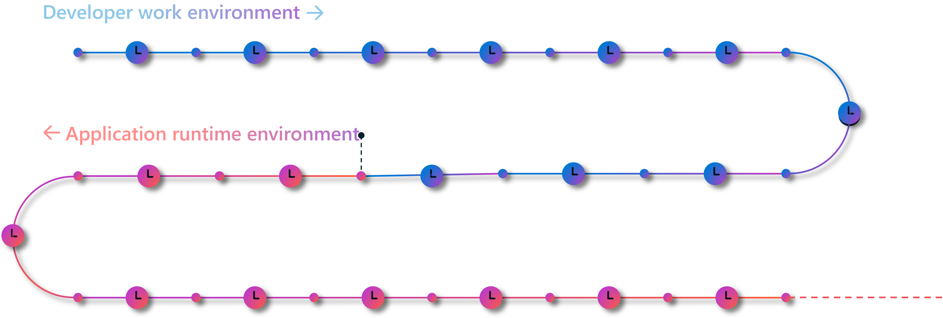
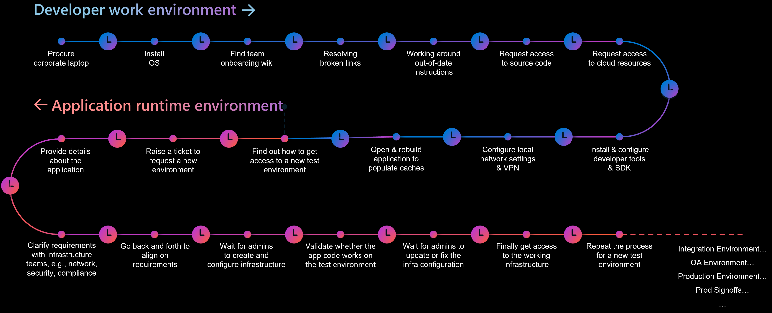
Onboarding
Project 2
Project 1
Project 3

Slide 9
WHO HERE HAS USED OR CURRENTLY USES A VM?

Slide 10
THINK OF CDES AS THE NEXT EVOLUTION OF THE VM

Slide 11





Scalability
Access from almost anywhere
traditional VDI
Virtual Desktop Infrastructure
allows for:
Security
Centralized management
Cost savings
But fail for developers because VDIs don’t adapt to dev workflows

Slide 12
Developer tool and service integrations
Development-ready
Self-service
Accessibility with remote access
Improved security
Ensure compatibility with production and staging environments
Provide access to more powerful or specialized hardware
Ephemeral (per project /feature) machines
cloud-based development environments
Cloud-based development environments
go beyond VDI:

Slide 13
CDE Fundamentals
a
Policy and management tools
Environment configuration
Personalization

Slide 14
about CDEs
Cloud-based development environments allow developers to focus on their tasks from anywhere, using almost any device.

Slide 15
MICROSOFT DEV BOX

Slide 16
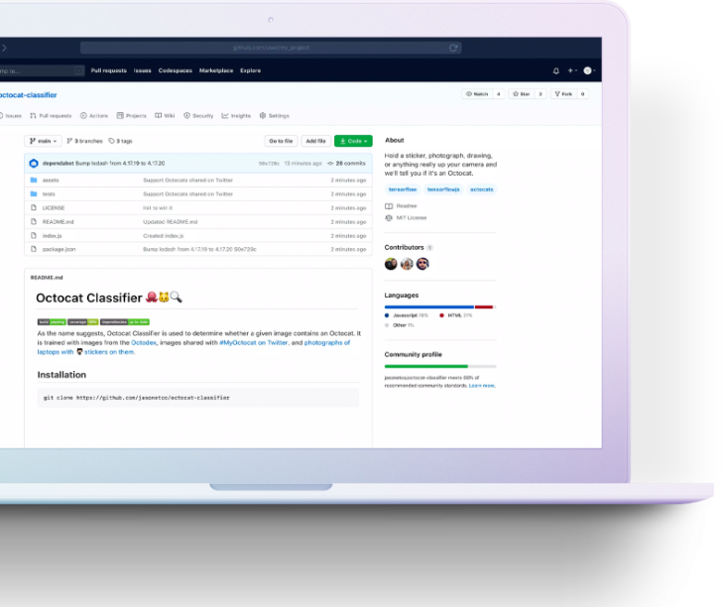
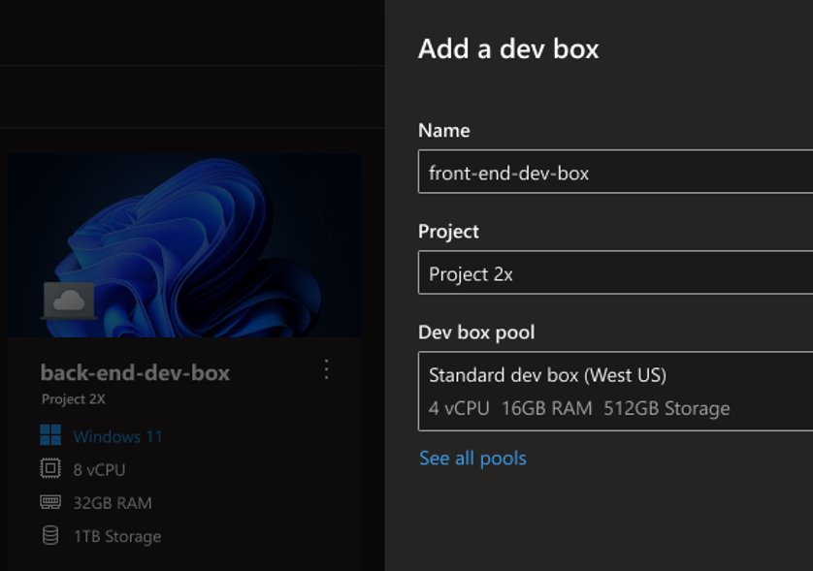
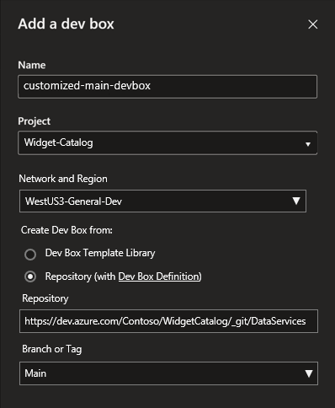


Microsoft Dev Box
Secure cloud workstations built for developer productivity
Ready-to-code
Project-based
Managed and secure

Slide 17
Self-service at the Dev Portal
Configure dev boxes by project
Centrally managed compliance
Dev Box SKU
Cost controls
Network configurations
Dev Box 1: high-compute workspace
Dev Box 2: data engineer workspace
Toolset customization
Dev experience settings
Security settings
Organizational policies
Developers
Deploy the Dev Boxes they need to work in their current projects
Dev Leads
Create pools of Dev Boxes tailored to developers’ projects and tasks
IT / Dev Infra Teams
Manage Dev Boxes via Intune and Microsoft Endpoint Manager

Slide 18
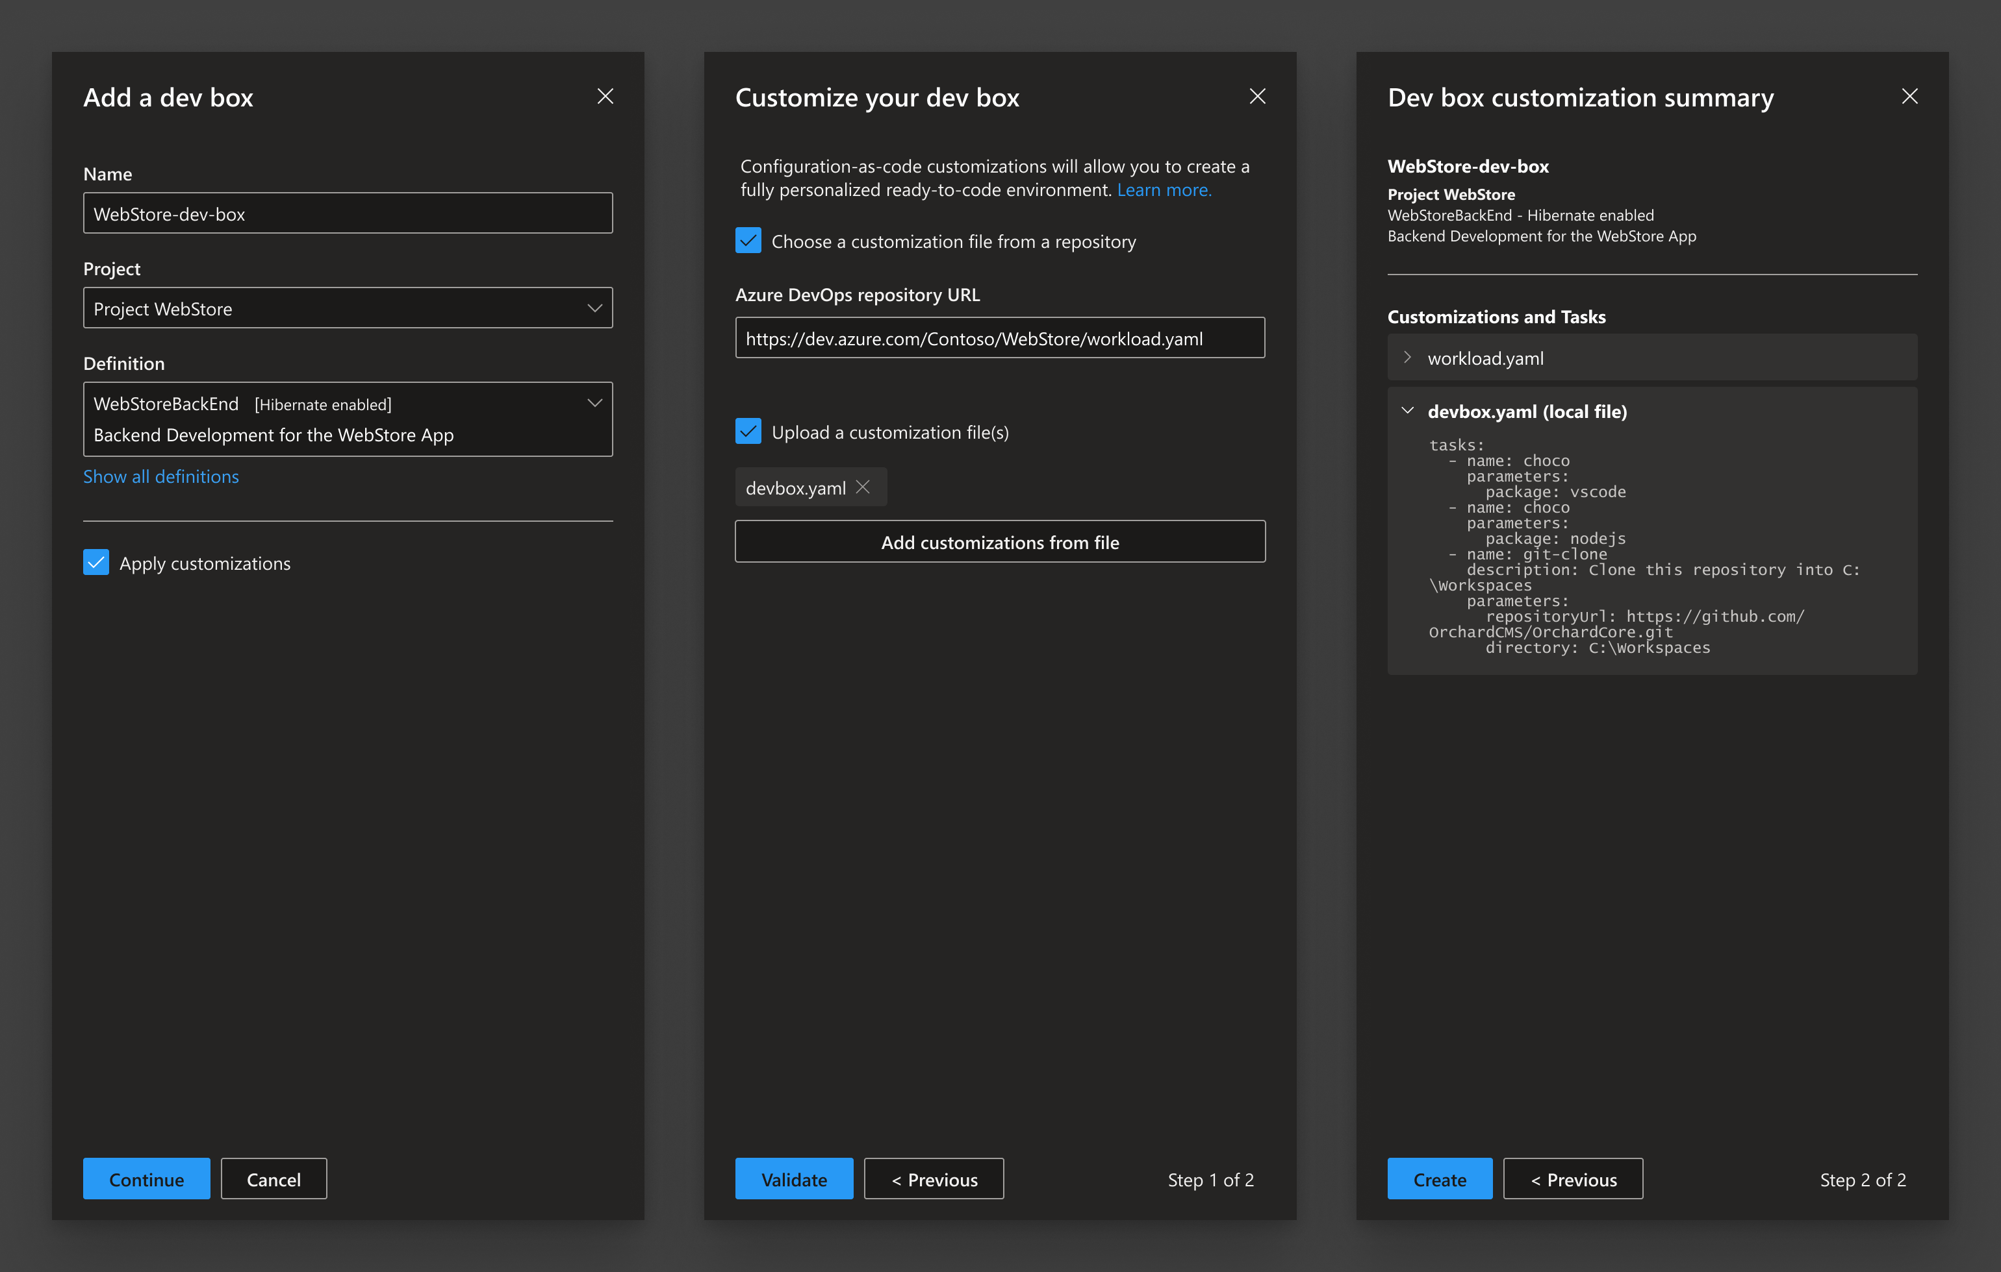
Customizations
Code-ready for you and your team.
Define tools, packages, and settings in your config-as-code
Private preview
Team customizations
Imaging
Preview
Individual customizations
Customizations in Dev Home
Project based catalogs

Slide 19





Manage dev boxes in the same way you manage physical desktops and laptops with Microsoft Intune
Microsoft Intune
Using Intune with Dev Box
Conditional access policies
Auto updates
Intune delivers Windows auto updates to dev boxes in the same way physically managed receive updates.
Set conditional access policies to manage approved devices, MFA sign-in, risk-based sign-in, and more
Advanced threat mitigation
Security enforced on specific workloads
IT admins can set up login and security policies to ensure sensitive workloads are managed in a compliant way
Keep endpoints secure with next-generation antivirus and threat vulnerability management
Endpoint analytics and insights
Ensure user satisfaction and streamline auditing with comprehensive reports into device health and usage

Slide 20
MICROSOFT DEV BOX
DEMO

Slide 21
GITHUB CODESPACES

Slide 22
Codespaces
Your on-demand dev environment
Code without compromise
Simplify your workflow
Extend and customize

Slide 23
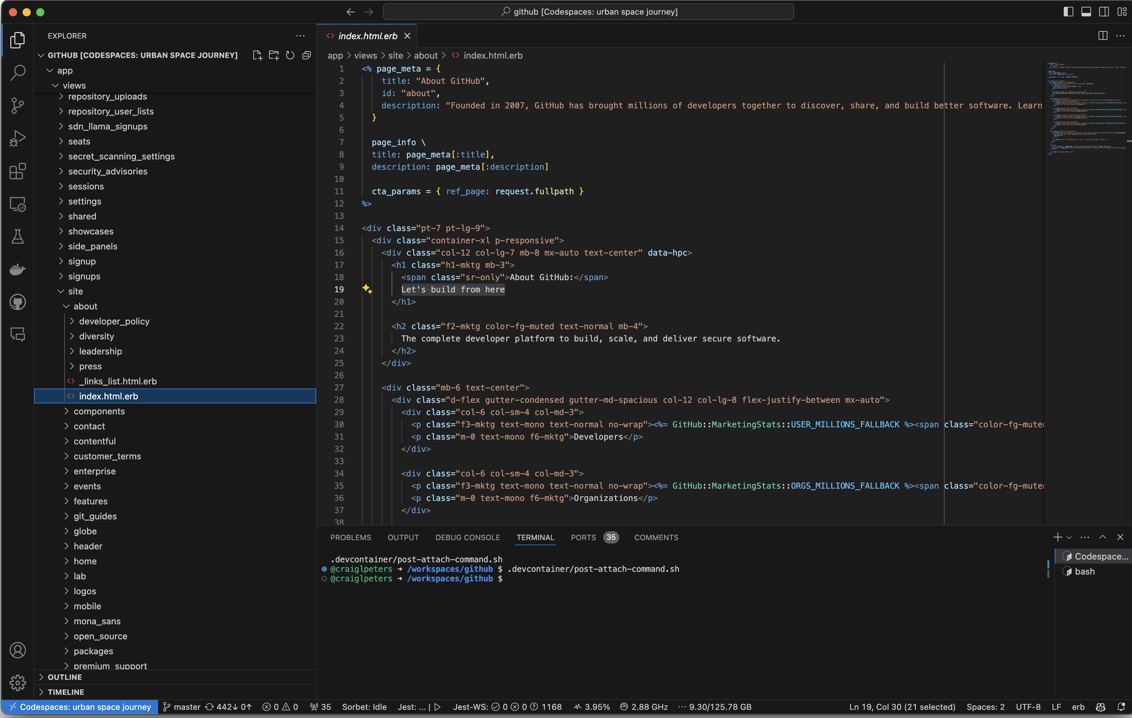
Codespaces
Features
Tight GitHub integration
Multiple configurations
Fast startup
Sharing create links
Personalization
Cost controls
Security controls

Slide 24
Codespaces
Configuration
devcontainer.json
Declarative
Portable
Composable
Open
Run remote or local
Use one of our base images,
or customize your own

Slide 25
GITHUB CODESPACES
DEMO

Slide 26
SO WHICH ONE DO I CHOOSE?

Slide 27

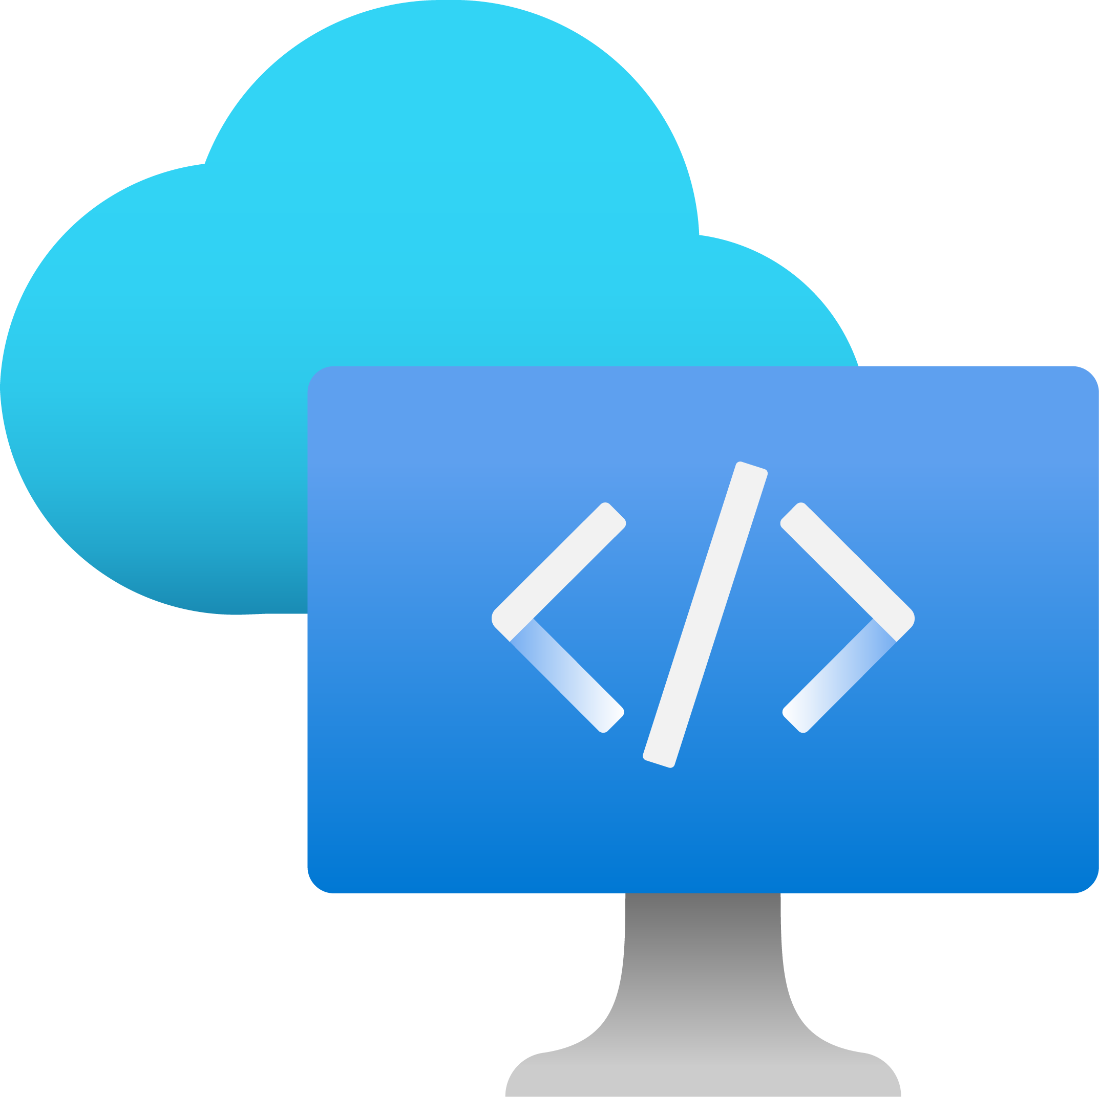

Microsoft Dev Box
GitHub Codespaces
Full dev workstations in the cloud optimized for enterprise-grade dev productivity and security
Cloud-based dev environments for fast, on-demand coding on any device
a
Operating system
Windows-based VMs with support for Linux through WSL capabilities
Linux-based containerized dev environments
SCM Support
Any version control system
Repos on GitHub
Tool support
Any Windows-based tool
Visual Studio Code, (beta) JetBrains IntelliJ
Any workload
Including: Desktop, on-prem deps, IoT, mobile, games,.. (Windows or cross-plat)
Cloud native apps
Including: web apps, APIs, backends
Target workloads
Security and governance
Microsoft Intune, Microsoft Azure
GitHub.com
DSC, winget
Configurations at team and individual user levels
JSON at the repository level
Define the container
Customizations

Slide 28
USE CASES
New employees, new to team
Consultants
Fast scaling teams
IP Protection and security
Legacy apps
Specialized hardware
Innovation, learning, & experimentation
Inner-source and open-source contributions
Cloud-based
Development environment

Slide 29
Getting started
1
Identify a champion
2
Start with a pilot team, project, and clear goals
3
Get started with Codespaces on Github.com
4
Build a Dev Box from a Visual Studio optimized developer image or start blank and build.

Slide 30

THANK YOU
https://isaacl.dev/cde-talk

